Slide 1



Master of Science in Computer Engineering
Rethinking Automotive Software Development: Exploring Software Defined Vehicle and its potential
Candidate
Lorenzo SCIARA
Supervisors
prof. Danilo Bazzanella
dott.sa Piera Limonet

Slide 2



MECHANICS
SOFTWARE
AGENDA

Slide 3

AUTOMOTIVE CONTEXT
In the past automotive industry software production was always considered secondary to the mechanical ones.
MECHANICS
SOFTWARE

Slide 4

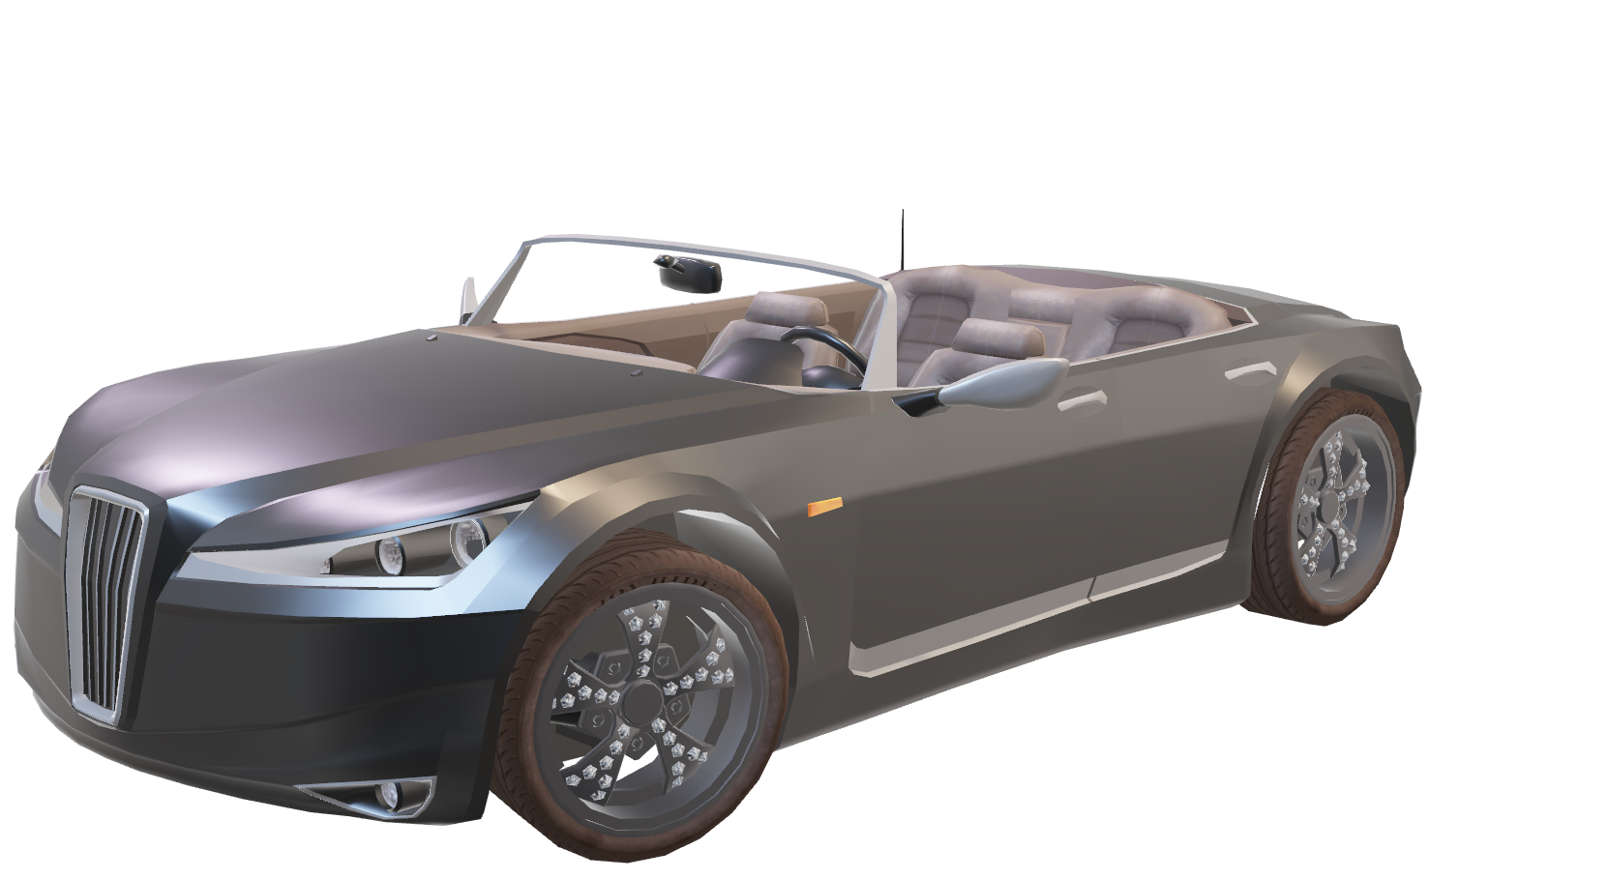

AUTOMOTIVE CONTEXT
The focus on the mechanical parts of the vehicle resulted in software being very dependent on the hardware
HARDWARE
MECHANICS
SOFTWARE
SOFTWARE

Slide 5

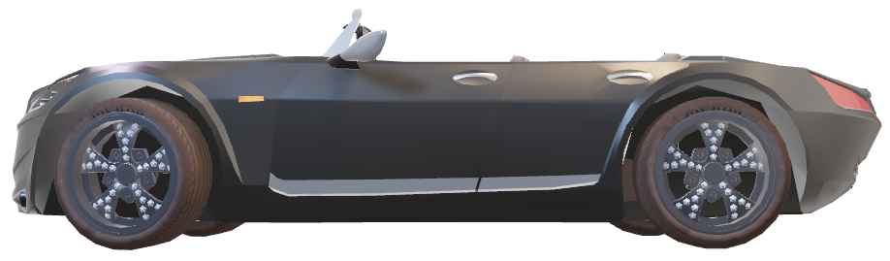
SOFTWARE DEFINED VEHICLE
Software Defined Vehicle enables software to become a fundamental element of vehicle design
SOFTWARE
MECHANICS
HARDWARE

Slide 6



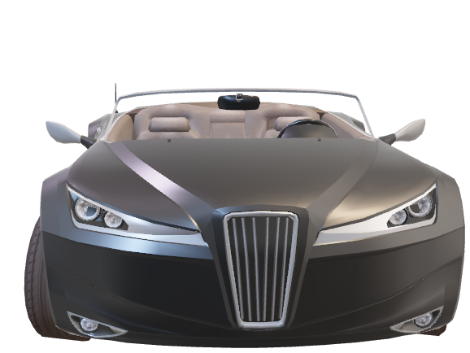
BENEFITS
SECURITY
EFFICIENCY
DURABILITY

Slide 7
BENEFITS
SECURITY
EFFICIENCY
DURABILITY
Vehicle vulnerabilities can be remotly fixed with OTA updates

Slide 8
BENEFITS
EFFICIENCY
SECURITY
DURABILITY
The software production is significantly increased thanks to the software independence

Slide 9
BENEFITS
DURABILITY
SECURITY
EFFICIENCY
vehicle lifecycle is increased through constant updates and the addition of new features

Slide 10
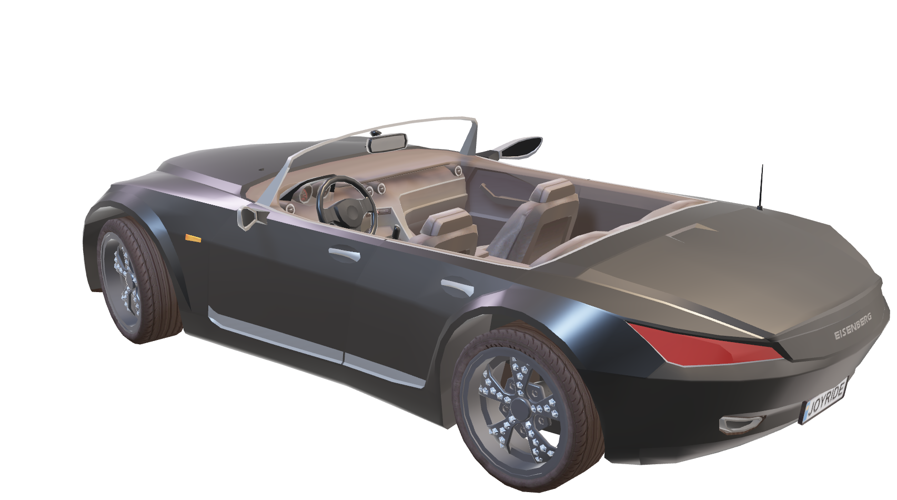
BENEFITS
Security
Efficency
Durability

Slide 11
CLOUD
AWS

Slide 12
CONTRIBUTORS
TCU simulator
AWS cloud infrastructure
Data viewer

Slide 13
FUTURE WORKS
Interact eith a real car
Study hawkbit
Integrate the work done for SDV with other IT vehicle systems

Slide 14
Thanks for the attention
Any questions?

